Slide 1
Device Management
Manish Ranjan Behera

Slide 2
Intro
Device management in an operating system means controlling the Input/output devices like disk, microphone, keyboard, printer, magnetic tape, USB ports, camcorder, scanner, other accessories, and supporting units like supporting units control channels.
There are three types of Operating system peripheral devices: dedicated, shared, and virtual.

Slide 3
Types of devices
Dedicated Device : In device management, some devices are allocated or assigned to only one task at a time until that job releases them.
Shared Device : Devices that can be shared or allocated between two or more processes at the same time are known as shared devices.
Virtual Device : is the combination of the above two discussed devices means when the dedicated devices are converted into shared devices then they are known as virtual devices.

Slide 4
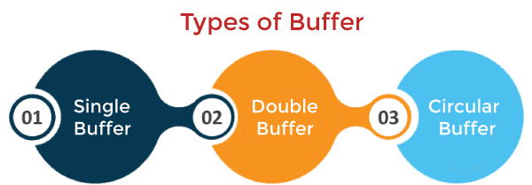
BuFFering
Buffering :- The buffer is an area in the main memory used to store or hold the data temporarily. In other words, buffer temporarily stores data transmitted from one place to another, either between two devices or an application. The act of storing data temporarily in the buffer is called buffering.

Slide 5
Types of buffer
Single Buffer : Only one buffer is used to transfer the data between two devices. The producer produces one block of data into the buffer. After that, the consumer consumes the buffer. Only when the buffer is empty, the processor again produces the data.
Double Buffer : Two buffers are used in the place of one. In this buffering, the producer produces one buffer while the consumer consumes another buffer simultaneously. So, the producer not needs to wait for filling the buffer.
Circular Buffer : When more than two buffers are used, the buffers' collection is called a circular buffer. Each buffer is being one unit in the circular buffer.

Slide 6
Spooling
Spooling is a process in which data is temporarily held to be used and executed by a device, program, or system. Data is sent to and stored in memory or other volatile storage until the program or computer requests it for execution.
The biggest example of Spooling is printing. The documents which are to be printed are stored in the SPOOL and then added to the queue for printing. During this time, many processes can perform their operations and use the CPU without waiting while the printer executes the printing process on the documents one-by-one.

Slide 7
Device driver
Device Driver in computing refers to a special kind of software program or a specific type of software application which controls a specific hardware device that enables different hardware devices for communication with the computer’s Operating System.
A device driver communicates with the computer hardware by computer subsystem or computer bus connected to the hardware.

Slide 8
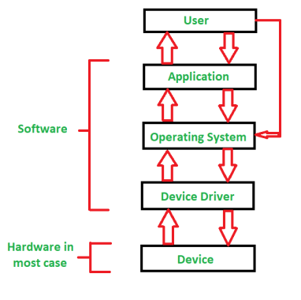

Slide 9
Disk Scheduling
Disk scheduling is done by operating systems to schedule I/O requests arriving for the disk. Disk scheduling is also known as I/O scheduling. Disk scheduling is important because:
Multiple I/O requests may arrive by different processes and only one I/O request can be served at a time by the disk controller. Thus other I/O requests need to wait in the waiting queue and need to be scheduled.
Hard drives are one of the slowest parts of the computer system and thus need to be accessed in an efficient manner

Slide 10
Disk Scheduling Algorithms
1. FCFS disk scheduling algorithm - It stands for 'first-come-first-serve'. As the name suggests, the request which comes first will be processed first and so on. The requests coming to the disk are arranged in a proper sequence as they arrive. Since every request is processed in this algorithm, so there is no chance of 'starvation'.
2. SSTF disk scheduling algorithm - It stands for 'Shortest seek time first'. As the name suggests, it searches for the request having the least 'seek time' and executes them first. This algorithm has less 'seek time' as compared to FCFS Algorithm.

Slide 11
3. SCAN disk scheduling algorithm: In this algorithm, the head starts to scan all the requests in a direction and reaches the end of the disk. After that, it reverses its direction and starts to scan again the requests in its path and serves them. Due to this feature, this algorithm is also known as the "Elevator Algorithm".
4. LOOK the disk scheduling algorithm: In this algorithm, the disk arm moves to the 'last request' present and services them. After reaching the last requests, it reverses its direction and again comes back to the starting point. It does not go to the end of the disk, in spite, it goes to the end of requests.

